Slide 1


Genetic Programming
Una-May OReilly
The Alfa Group: AnyScale Learning for All
CSAIL, MIT
unamay@csail.mit.edu
http://groups.csail.mit.edu/ALFA
text: +1-617-875-3889

Slide 2
Instructor: Una-May O’Reilly
Leader: AnyScale Learning For All Group, MIT CSAIL
Experience solving real world, complex problems requiring machine learning and/or evolutionary computation
Projects
Scalable ML
Trajectories Like Mine: Locality Sensitive Hashing
ICU acute event prediction:
E-learning stopout prediction
Co-evolutionary Algorithms
Secure Networks through Adversarial Modeling (RIVALS)
Tax Avoidance Detection (STEALTH)
Distributed GA
Circuits, network coding
Sparse matrix data mapping on parallel architectures
Wind Farm Turbine layout (also developmental)
GP Applications
Finance
Flavor design
Focus on innovation in genetic programming
Improving competence
MRGP, EFS, Behavioral GP
2

Slide 3
Some Thoughts
S3 is an awesome opportunity
work together!
recognize different levels of expertise
debate, critique, respect
integrate S3 with GECCO
I am learning with every presentation
Genetic Programming is intellectually captivating!
GP is a program that evolves programs
PROGRAMS ARE POWERFUL!
they are general
If true AI is possible, then a program can be intelligent

Slide 4


Slide 5
Agenda
Introduction to GP algorithm,
assumes some familiarity with genetic algorithms or evolutionary strategies
GP design properties
Set groundwork for self-learning
Assignments
Challenge
3 Papers
5

Slide 6
Intro to GP
GP is the genetic evolution of executable expressions
Black box example of GP symbolic regression
Tree-based GP:
tree-based representation and crossover
GP system
Nuts and Bolts Descriptions of Algorithm Components
Resources and reference material
Agenda
6

Slide 7
What Makes Programming Challenging?
requires understanding the problem,
assembling an algorithm or methodology,
demands design systematicity
can require
decomposition,
re-use
complex logic

Slide 8
What Makes Program Search Challenging?
programs can’t be predetermined in terms of length or logic structure
the representation cannot be fixed length
lose the position-based meaning of an evolvable unit
need to express hierarchical logic
variation must still assure syntactic correctness
won’t be understood by compiler or interpreter
variation must still assure program doesn’t crash
divide by zero
array overflow
infinite loops
have to search a large (but finite) varying length search space

Slide 9
Problem Domains where GP is Used
GP is the search for correct
executable expressions
Program repair
Automatic programming
Cyber-security (heterogeneous programs for one function)
System identification aka symbolic regression, modeling
Symbolic regression is a form of supervised machine learning
GP offers some unsupervised ML techniques as well
Clustering
Evolutionary Computation and Evolutionary Algorithms
9

Slide 10
Black Box Example of GP Symbolic Regression
http://flexgp.csail.mit.edu
http://flexgp.github.io/gp-learners/sr.html
http://flexgp.github.io/gp-learners/blog.html
S/W by ALFA Group’s FlexGP team
Special recognition to Ignacio Arnaldo, PhD who prepared SR Learner tutorial and blog post

Slide 11
Regression
Inputs
Output
System
F(X)
x1⁴
x1³
x1²
x1¹
x2⁴
x2³
x2²
x2¹
y³
y²
y¹
x3⁴
x3³
x3²
x3¹
AKA
Explanatory variables
Independent variables
Manipulated variables
Control variables
features
Response variable
Dependent variable
label
GOAL: FIND F(X) THAT GENERATES Y

Slide 12
A Black Box GP Symbolic Regression Learner
For non-researchers
Use for numerical datasets
training and testing the retrieved models
Easy parameter changing through a central file
sr.jar
Only supported for Debian linux
Source is on http://flexgp.github.io
Referred to as baseline in ALFA group publications
Multiple regression genetic programming, Ignacio Arnaldo, Krzysztof Krawiec, Una-May O'Reilly, GECCO '14, pp 879--886.
FlexGP: Cloud-Based Ensemble Learning with Genetic Programming for Large Regression Problems, Kalyan Veeramachaneni, Ignacio Arnaldo, Owen Derby, Una-May O’Reilly. Journal Of Grid Computing 13(3): 391-407, (Mar 2015)
Option to accelerate runs with C++ optimized execution
Requires gcc and g++ compilers, configuring Linux kernel parameter governing the maximum size of shared memory segments
Option to accelerate runs with CUDA (GPU)
Added requirement of nvcc compiler
append the -cuda flag, make some extra directories…

Slide 13


GP is an EA
Each generation
select
breed
replace
population = random_pop_init()
generation = 0
while needToStop == false
generation++
phenotypes =decoder(genotypes)
calculateFitness(phenotypes)
parents = select (phenotypes)
offspring = breed(parents.genotypes)
population = replace(parents, offspring)
solution = bestOf(population)
recheck(needToStop)
13

Slide 14
What Makes GP Different from Other EAs
The search space is a set of programs
genome representation of an executable expression
NOT fixed length, NOT position implied meaning
varying length
hierarchical
position-free meaning
today: tree-based GP (Koza, 92)
decoding
every candidate solution is a different expression with (implicit) formal parameters
bind an prepared set of inputs to formal as actual parameters
fitness:
expression evaluated with some special care
for each evaluation, error = output – desired output
sum for many sets of inputs
variation
different crossover and mutation operators

Slide 15
Koza’s Executable Expressions
Pioneered circa 1988
Lisp S-Expressions
Composed of primitives called ‘functions’ and ‘terminals’
Example:
primitives:
Operators/Functions
+ - * div
arity 2
Terminals: a b c d 4
arity 0
S-Expression
(*(- (+ 4 c) b) (div d a))
Eval/execuate In a Lisp interpreter:
bind a b c and d
Evaluate expressions
% Lisp interpreter
(set! a 2) -> 2
(set! b 4) -> 4
(set! c 6) -> 6
(set! d 8) -> 8
(*(- (+ 4 c) b) (div d a)) -> 12
; Rule Example
(if (= a b) c d) -> 8
;Predicate:
(> c d) -> nil
GP Evolves Executable Expressions
15

Slide 16
GP Representation: Abstract Syntax Trees
+
+
X1
X2
-
max
Inorder: X1 + X2
X1
X2
X2
X4
preorder: + X1 X2
Post-order: X1 X2 +
Inorder: (x1-x2) + (x2 max x4)
preorder: (+ (- X1 X2) (max X2 X4))
Post-order: X1 X2 -) (X2 X4 max) +)
Whether parsed preorder (node, left-child, right-child) or
postorder (left-child, right-child, node) or inorder (left, node, right)
the expression evaluates to the same result
(tree)GP uses an expression tree as its genotype structure
GP Evolves Executable Expressions
16

Slide 17
GP Tree Crossover
Parent 1
if
Parent 2
if
and
G
R
not
S
T
<
=
>
av
t2
t3
max
sum
sum
t1
t4
t1
t5
t2
Child 1
if
Child 2
if
and
G
R
S
T
not
<
>
=
av
t2
sum
sum
t3
max
t1
t1
t5
t4
Nuts and Bolts GP Design
17
Notes:
Note the difference here with GA or ES!!!
No positional coding in the representation

Slide 18
Tree Crossover Details
Crossover point in each parent is picked at random
Conventional practices
All nodes with equal probability
leaf nodes chosen with 0.1 probility and non-leaf with 0.9 probability
Probability of crossover
Typically 0.9
Maximum depth of child is a run parameter
Typically ~ 15
Can be size instead
Two identical parents rarely produce offspring that are identical to them
Tree-crossover produces great variations in offspring with respect to parents
Crossover, in addition to preserving syntax, allows expressions to vary in length and structure (sub-expression nesting)
Nuts and Bolts GP Design
18

Slide 19
GP Tree Mutation
Often only crossover is used
But crossover behaves often like macro-mutation
Mutation can be better tuned to control the size of the change
A few different versions
Nuts and Bolts GP Design
19

Slide 20
HVL-Mutation: substitution, deletion, insertion
Parent
if
Mutant-subst
if
and
G
R
and
G
R
<
=
<
=
av
t2
t3
max
av
t2
t1
max
t1
t4
t1
t4
if
if
Mutant-deletion
Mutant-addition
and
G
R
and
G
R
<
=
<
=
av
t2
t3
av
t2
max
max
t4
t1
t1
t3
t4
Nuts and Bolts GP Design
20

Slide 21
Population Initialization
Fill population with random expressions
Create a function set Φ and a corresponding function-arity set
Create an terminal set (arg-count = 0), Τ
draw from F with replacement and recursively enumerate its argument list by additional draws from Φ U Τ.
Recursion ends at draw of a terminal
requires closure and/or typing
maximum tree height parameter
At max-height-1, draw from Τ only
“ramped half-half” method ensures diversity
equal quantities of trees of each height
half of height’s trees are full
For full tree, only draw from terminals at max-height-1
Nuts and Bolts GP Design
21

Slide 22
Determining a Expression’s Fitness
One test case:
Execute the expression with the problem decision variables (ie terminals) bound to input values and initialize side effect values
Designate the “result” of the expression
Measure the error between the correct output values for the inputs and the result of the expression
Final output may be side effect variables, or return value of expression
Eg. Examine expression result and expected result for regression
Eg. the heuristic in a compilation, run the binary with different inputs and measure how fast they ran.
EG, Configure a circuit from the genome, test the circuit with an input signal and measure response vs desired response
Usually have more than one test case but cannot enumerate them all
Use rational design to create incrementally more difficult test cases (eg block stacking)
Use representative data for regression, program synthesis
Nuts and Bolts GP Design
22

Slide 23
How does my GP system execute an expression?
Answer:
It uses an external, built-in interpreter
Lisp GP system calls LISP interpreter
It compiles and executes the compilation results
It includes its own interpreter and uses that
eg. PonyGP.py (flexgp web site)

Slide 24
A Lisp GP system
A Lisp GP system is a large set of functions which are interpreted by evaluating the entry function
Some are definitions of primitives you write!
(defun div …)
Rest is software logic of an evolutionary algorithm
Any GP system has a set of functions that are pre-defined (by compilation or interpretation) for use as primitives
also has software logic that handles
Population initialization, iteration, selection, breeding, replacement
GP expressions are first class objects in LISP so the GP software logic can manipulate them as data as well as have the interpreter read and evaluate them
GP Evolves Executable Expressions
24

Slide 25
Details When Trying to Solve a Problem with GP
Assure sufficiency
Make sure a solution can be plausibly expressed when choosing your primitive set
Functions must be wisely chosen but not too complex
General primitives: arithmetic, boolean, condition, iteration, assignment
Problem specific primitives
Can you handcode a naïve solution?
Balance flexibility with search space size
Assure closure
Design functions with wrappers that accept any type of argument
Often types will semantically clash…need to have a way of dealing with this
GP Evolves Executable Expressions
25

Slide 26
GP Preparatory Steps
Assume we have a GP system with internal expression evaluator.
Decide upon functions and terminals
Terminals bind to decision variables in problem (or constants)
Combinatorial expression space defines the search space
Set up the fitness function
Translation of problem goal to GP goal
Minimization of error between desired and evolved expression when executed
Maximization of a problem based score
Decide upon run parameters
Population size is most important with num_generations
Budget driven or resource driven
GP is robust to many other parameter choices
Determine a halt criteria and result to be returned
Maximum number of fitness evaluations
Time
Minimum acceptable error
Good enough solution (satisficing)
Nuts and Bolts GP Design
26

Slide 27
PonyGP: a Python GP system
ponyGP.py https://flexgp.github.io/pony_gp/
Available from github: https://github.com/flexgp/pony_gp
Example solves symbolic regression with a set of fitness cases in a CSV file that is split into training and test.
The specific function is x0^2 + x1^2=y
This code has
elitism option (handled in generational_replacement function)
randomized full and grow half-half initialization (full as option too)
tournament selection
subtree_crossover and subtree_mutation
a basic population per generation report
documentation
one function "evaluate" which interprets the symbols and trees/genome
definitions of symbols which programmer updates (get_symbols)
27

Slide 28
Top Level GP Algorithm
Begin
pop = random programs from a set of operators and operands
repeat
execute each program in pop with each set of inputs
measure each program’s fitness
repeat
select 2 parents
copy 2 offspring from parents
crossover
mutate
add to new-pop
until pop-size
pop = new-pop
until max-generation
or
adequate program found
End
Grow or Full
Ramped-half-half
Max-init-tree-height
Tournament selection
Fitness proportional selection
Your favorite selection
Prepare input data
Designate solution
Define error between actual
and expected
Tournament size
HVL-mutate
Subtree subst
Permute
Edit
Your own
Sub-tree crossover
Mutation probs
Prob to crossover
Max-tree-height
Leaf:node bias
Nuts and Bolts GP Design - Summary
28

Slide 29
GP Parameters
Population size
Number of generations
Max-height of trees on random initialization
Typically 6
Probability of crossover
Higher than mutation
0.9
Rest of offspring are copied
Probability of mutation
Probabilities of addition, deletion and insertion
Population initialization method
Ramped-half-half
All full
All non-full
Selection method
Elitism?
Termination criteria
Fitness function
what is used as “solution” of expression
Nuts and Bolts GP Design
29

Slide 30
What Makes GP’s Search Successful?
programs are not predetermined in terms of length or logic structure
the representation is not fixed length
hierarchical logic
sub-tree crossover and closure ensure syntactic correctness
program doesn’t crash GP system
protected divide by zero
protected array overflow
timeout on infinite loops
evolutionary selection and variation ?effectively? search a large (but finite) varying length search space

Slide 31
GP Topics
How to expand upon program behavior feedback?
program trace
test case behavior
input differentiation
output differentiation
“Behavioral GP”
Scaling
Coevolution
cooperation
competition

Slide 32
PonyGP: a Python GP system
ponyGP.py https://flexgp.github.io/pony_gp/
Available from github: https://github.com/flexgp/pony_gp
Example solves symbolic regression with a set of fitness cases in a CSV file that is split into training and test.
The specific function is x0^2 + x1^2=y
This code has
elitism option (handled in generational_replacement function)
randomized full and grow half-half initialization (full as option too)
tournament selection
subtree_crossover and subtree_mutation
a basic population per generation report
documentation
one function "evaluate" which interprets the symbols and trees/genome
definitions of symbols which programmer updates (get_symbols)
32

Slide 33
PonyGP: Simple Symbolic Regression
Given a set of independent decision variables and corresponding values for a dependent variable
Want: a model that predicts the dependent variable
Eg: linear model with numerical coefficients
Y= aX1 + bX2 + c(X1X2)
Eg: non-linear model
y= a x1² + bx2³
Prediction accuracy: minimum error between model prediction and actual samples
Usually: designer provides a model and a regression (ordinary least squares, Fourier series) determines coefficients
With genetic programming, the model (structure) and the coefficients can be learned
Example: y=f(x)
Domain of x [-1.0,+1.0]
Choose the operands
X
Choose the operators
+, - , *, / (protected)
Maybe also sin, cos, exp, log (protected)
Fitness function: sum of absolute error between yi, and expression’s return values
Prepare 20 points for test cases
Test problem:
Y=x4 + x3 + x2 + x
GP can create coefficients (x/x div x+x = 1/2) but…
GP Examples
33

Slide 34
ALFA GP Software
http://flexgp.csail.mit.edu/ and http://flexgp.github.io/gp-learners/
FlexGP
one learner: MRGP for machine learning
a bare-metal cloud deployment (bit rot?)
data-parallel GP scale out
FCUBE – GP for classification http://flexgp.github.io/FCUBE/
lets you develop your own classifier and run easily on the cloud with simple interfaces
runs 2 different ALFA learners already
ran different learners from 2014 competition at GECCO
Bring Your Own Learner! A cloud-based, data-parallel commons for machine learning,
Ignacio Arnaldo, Kalyan Veeramachaneni, Andrew Song, Una-May O’Reilly.
IEEE Computational Intelligence Magazine. Special Issue on Computational Intelligence for Cloud Computing
(Feb. 2015), Vol 10, Issue 1, pp 20-32.
see groups.csail.mit.edu/ALFA/publications
CCUBE: classification, GECCO 2017
BGP: behavioral GP, GECCO 2014, GPTP 2017

Slide 35
Reference Material
http://geneticprogramming.com/
Genetic Programming Bibiliography
http://www.cs.bham.ac.uk/~wbl/biblio/
Online Material
ACM digital library: http://portal.acm.org/
GECCO conferences
GP conferences (pre GECCO),
Evolutionary Computation Journal (MIT Press)
IEEE digital library: http://www.computer.org/portal/web/csdl/home
Congress on Evolutionary Computation (CEC)
IEEE Transactions on Evolutionary Computation
Springer digital library: http://www.springerlink.com/
European Conference on Genetic Programming: “EuroGP”
35

Slide 36
GP Software
Commonly used in published research (and somewhat active):
Heuristic lab (using grammar guided GP) , GEVA (UCD)
EPOCHx
DEAP, JGAP
Java: ECJ, TinyGP,
Matlab: GPLab, GPTips
C/C++: MicroGP
Python: Ponygp, oop_ponyGP.py, DEAP, PyEvolve
.Net: Aforge.NET
http://flexgp.github.io/gp-learners/index.html
Others
http://www.epochx.org/index.php
Strongly typed GP, Grammatical evolution, etc
Lawrence Beadle and Colin G Johnson
http://www.tc33.org/genetic-programming/genetic-programming-software-comparison/
Dated Feb 15, 2011
36

Slide 37
Genetic Programming Benchmarks
Genetic programming needs better benchmarks
James McDermott, David R. White, Sean Luke, Luca Manzoni, Mauro Castelli, Leonardo Vanneschi, Wojciech Ja ́skowski, Krzysztof Krawiec, Robin Harper, Kenneth De Jong, and Una-May O’Reilly.
In Proceedings of GECCO 2012, Philadelphia, 2012. ACM.
Related benchmarks wiki
http://GPBenchmarks.org
37

Slide 38
Software Packages for Symbolic Regression
No Source code available
Datamodeler - mathematica, Evolved Analytics
Eureqa II/ Formulize - a software tool for detecting equations and hidden mathematical relationships in data
http://creativemachines.cornell.edu/eureqa
Plugins to Matlab, mathematica, Python
Convenient format for data presentation
Standalone or grid resource usage
Windows, Linux or Mac
http://www.nutonian.com/ for cloud version
Discipulus™ 5 Genetic Programming Predictive Modelling
38

Slide 39
Reference Material - Books
Genetic Programming, James McDermott and Una-May O'Reilly, In the Handbook of Computational Intelligence, Topic Editors: Dr. F. Neumann and Dr. K Witt, Editors in Chief Prof. Janusz Kacprzyk and Prof. Witold Pedrycz.
Essentials of Metaheuristics, Sean Luke, 2010
Genetic Programming: From Theory to Practice
10 years of workshop proceedings, on SpringerLink, edited
A Field Guide to Genetic Programming, Poli, Langdon, McPhee, 2008, Lulu and online digitally
Advances in Genetic Programming
3 years, each in different volume, edited
John R. Koza
Genetic Programming: On the Programming of Computers by Means of Natural Selection, 1992 (MIT Press)
Genetic Programming II: Automatic Discovery of Reusable Programs, 1994 (MIT Press)
Genetic Programming III: Darwinian Invention and Problem Solving, 1999 with Forrest H Bennett III, David Andre, and Martin A. Keane, (Morgan Kaufmann)
Genetic Programming IV: Routine Human-Competitive Machine Intelligence, 2003 with Martin A. Keane, Matthew J. Streeter, William Mydlowec, Jessen Yu, and Guido Lanza
Linear genetic programming, Markus Brameier, Wolfgang Banzhaf, Springer (2007)
Genetic Programming: An Introduction, Banzhaf, Nordin, Keller, Francone, 1997 (Morgan Kaufmann)
39

Slide 40
Assignment A: Behavioral Genetic Programming
This is a means of using subprogram behavioral information to inform evolutionary selection and variation.
Part 1:
Novice/Intermediate/Advanced: Read “Behavioral Programming: A Broader and More Detailed Take on Semantic GP”. Krzysztof Krawiec, Una-May O'Reilly. GECCO 2014, pp 935-94.
Part 2:
Novice/Intermediate/Advanced: Investigate the open source code for BGP in Java, i.e. run it and poke around the source code. The link to the github repository is https://github.com/flexgp/BehavioralGP. Use the master branch.
There is a GPTP 2017 paper on an extension to BGP in the S3 shared folder named Una-May O’Reilly/BGP_GPTP2017_FINE_HEMBERG_KRAWIEC_OREILLY.pdf.
See: https://drive.google.com/drive/folders/0B_5mciNE35JFSlBfRjRsMHNoWkU?usp=sharing
Part 3:
Novice: Provide a tutorial and set of external documentation for the software project.
Intermediate: Add 1 or more new GP problems to the BGP code base and request a github pull to have your source code become part of the project.
Advanced: Develop a new way to exploit the subprogram fitness information BGP provides.

Slide 41
Assignment B:Coevolution and GP
Part 1: Novice/Intermediate/Advanced:
Read Elena Popovici, Anthony Bucci, R Paul Wiegand, and Edwin D De Jong. 2012. Coevolutionary principles. In Handbook of Natural Computing. Springer, 987–1033. (I can provide a pdf of this if you can’t obtain it)
Part 2: Novice/Intermediate/Advanced:
Investigate the latest open source code release of PonyGP which has a bare-bones integration of coevolution, i.e. run it and poke around the source code. This code is written in Python. URL to come.
Part 3: Intermediate/Advanced:
Extend PonyGP+Coev with some enhancement. E.g., either improve its current example or provide another example. Depending on your coding expertise and knowledge of GP and coevolution, set an appropriately challenging goal.
See Andrea Arcuri and Xin Yao. 2007. “Coevolving programs and unit tests from their specification.” In Proceedings of the twenty-second IEEE/ACM international conference on Automated software engineering. ACM, 397–400 for an example if you’re stumped for ideas.

Slide 42
Assignment C: Distributed GP
Part 1: Identify a paper or web-documented project on a distributed GP system that has software associated with it.
I provide pointers to a number of examples.
Part 2 (optional): Try to run the software, i.e. run it and poke around the source code. This may require you to have extensive cloud scaling experience on OpenStack or AWS. Or you may need CUDA experience. If you don’t this is likely not a good assignment to choose.
Part 3. Design and plan how you would investigate an open GP problem with the system (i.e. integrate a new research investigation with it, not the one the original authors used to demo it.) Consider how specific needs interact with the desire for libraries/frameworks to be general.

Slide 43
Expected output and deliverable:
I. Presentation material: 3 slides on the paper, 5 slides on the source code covering codebase description, your appraisal and list of MUST-Do’s and WOULD-BE-NICE remarks. 10 minutes to present this
II. For coding in part 3: a demo shown to Una-May (and other mentors possibly).

Slide 44
Challenge
Sun 4:10 - 6pm
W21: Genetic and Evolutionary Computation in Defense, Security, and Risk Management (SecDef),
First Talk at 4:10
Challenge: Compare and contrast the value of 3 different solution concepts used in the coevolutionary algorithm for network security.

Slide 45
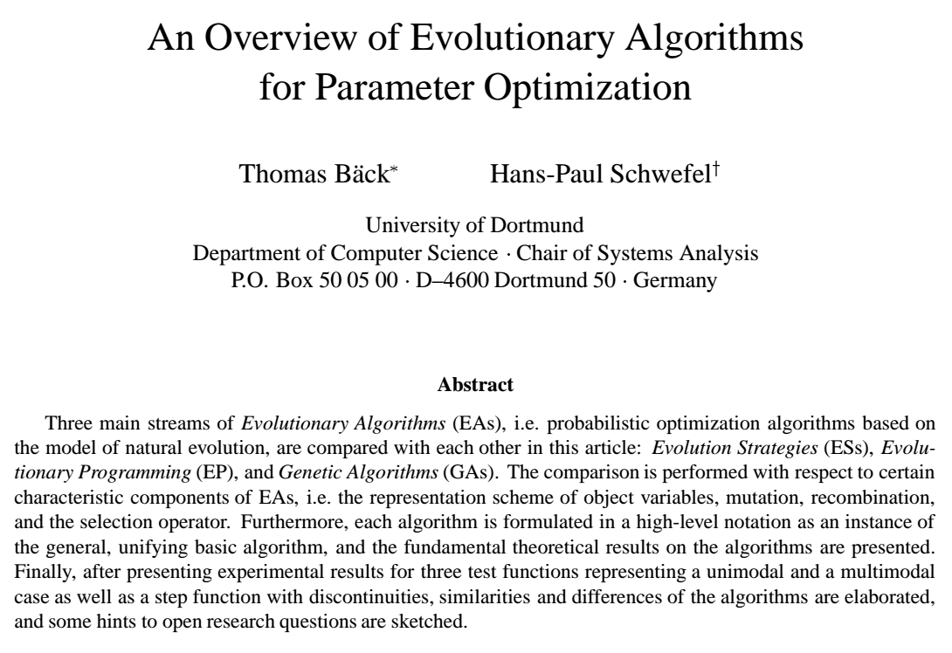
Summary Papers
Notes:
1993

Slide 46
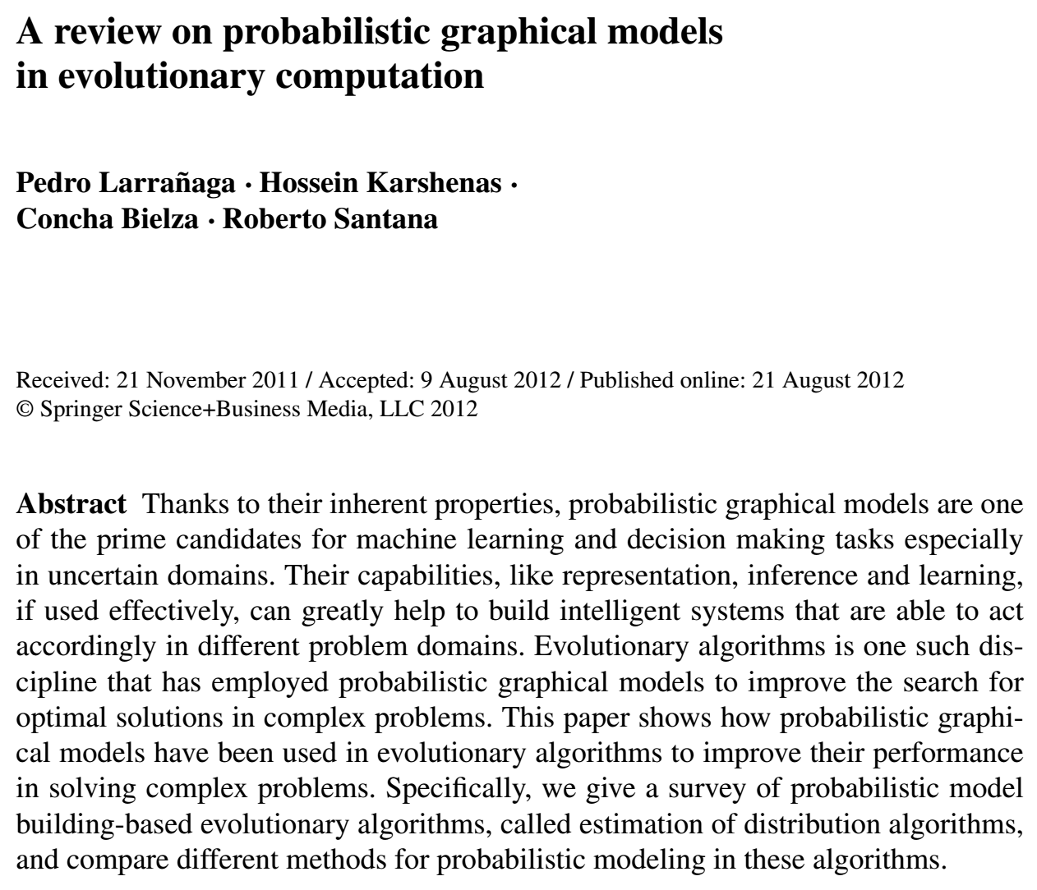

Slide 47
